Slide 1

Digital Sign With Raspberry Pi
Philip King

Slide 2
The Project: Purpose
Build a digital sign, for business setting
Allows user to press 1 of 4 buttons
Each button calls a specific report
Report would update every 5 minutes

Slide 3
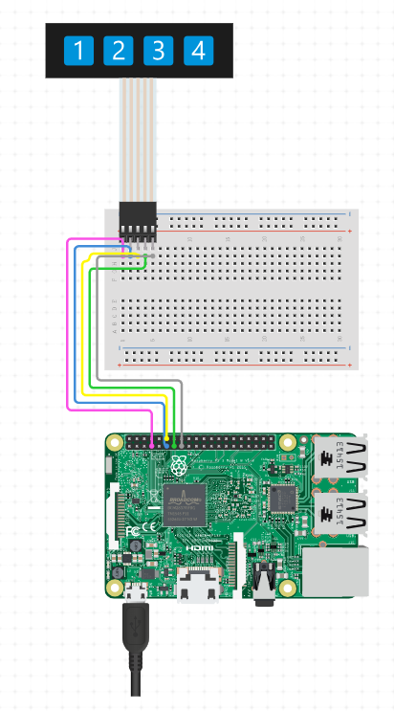
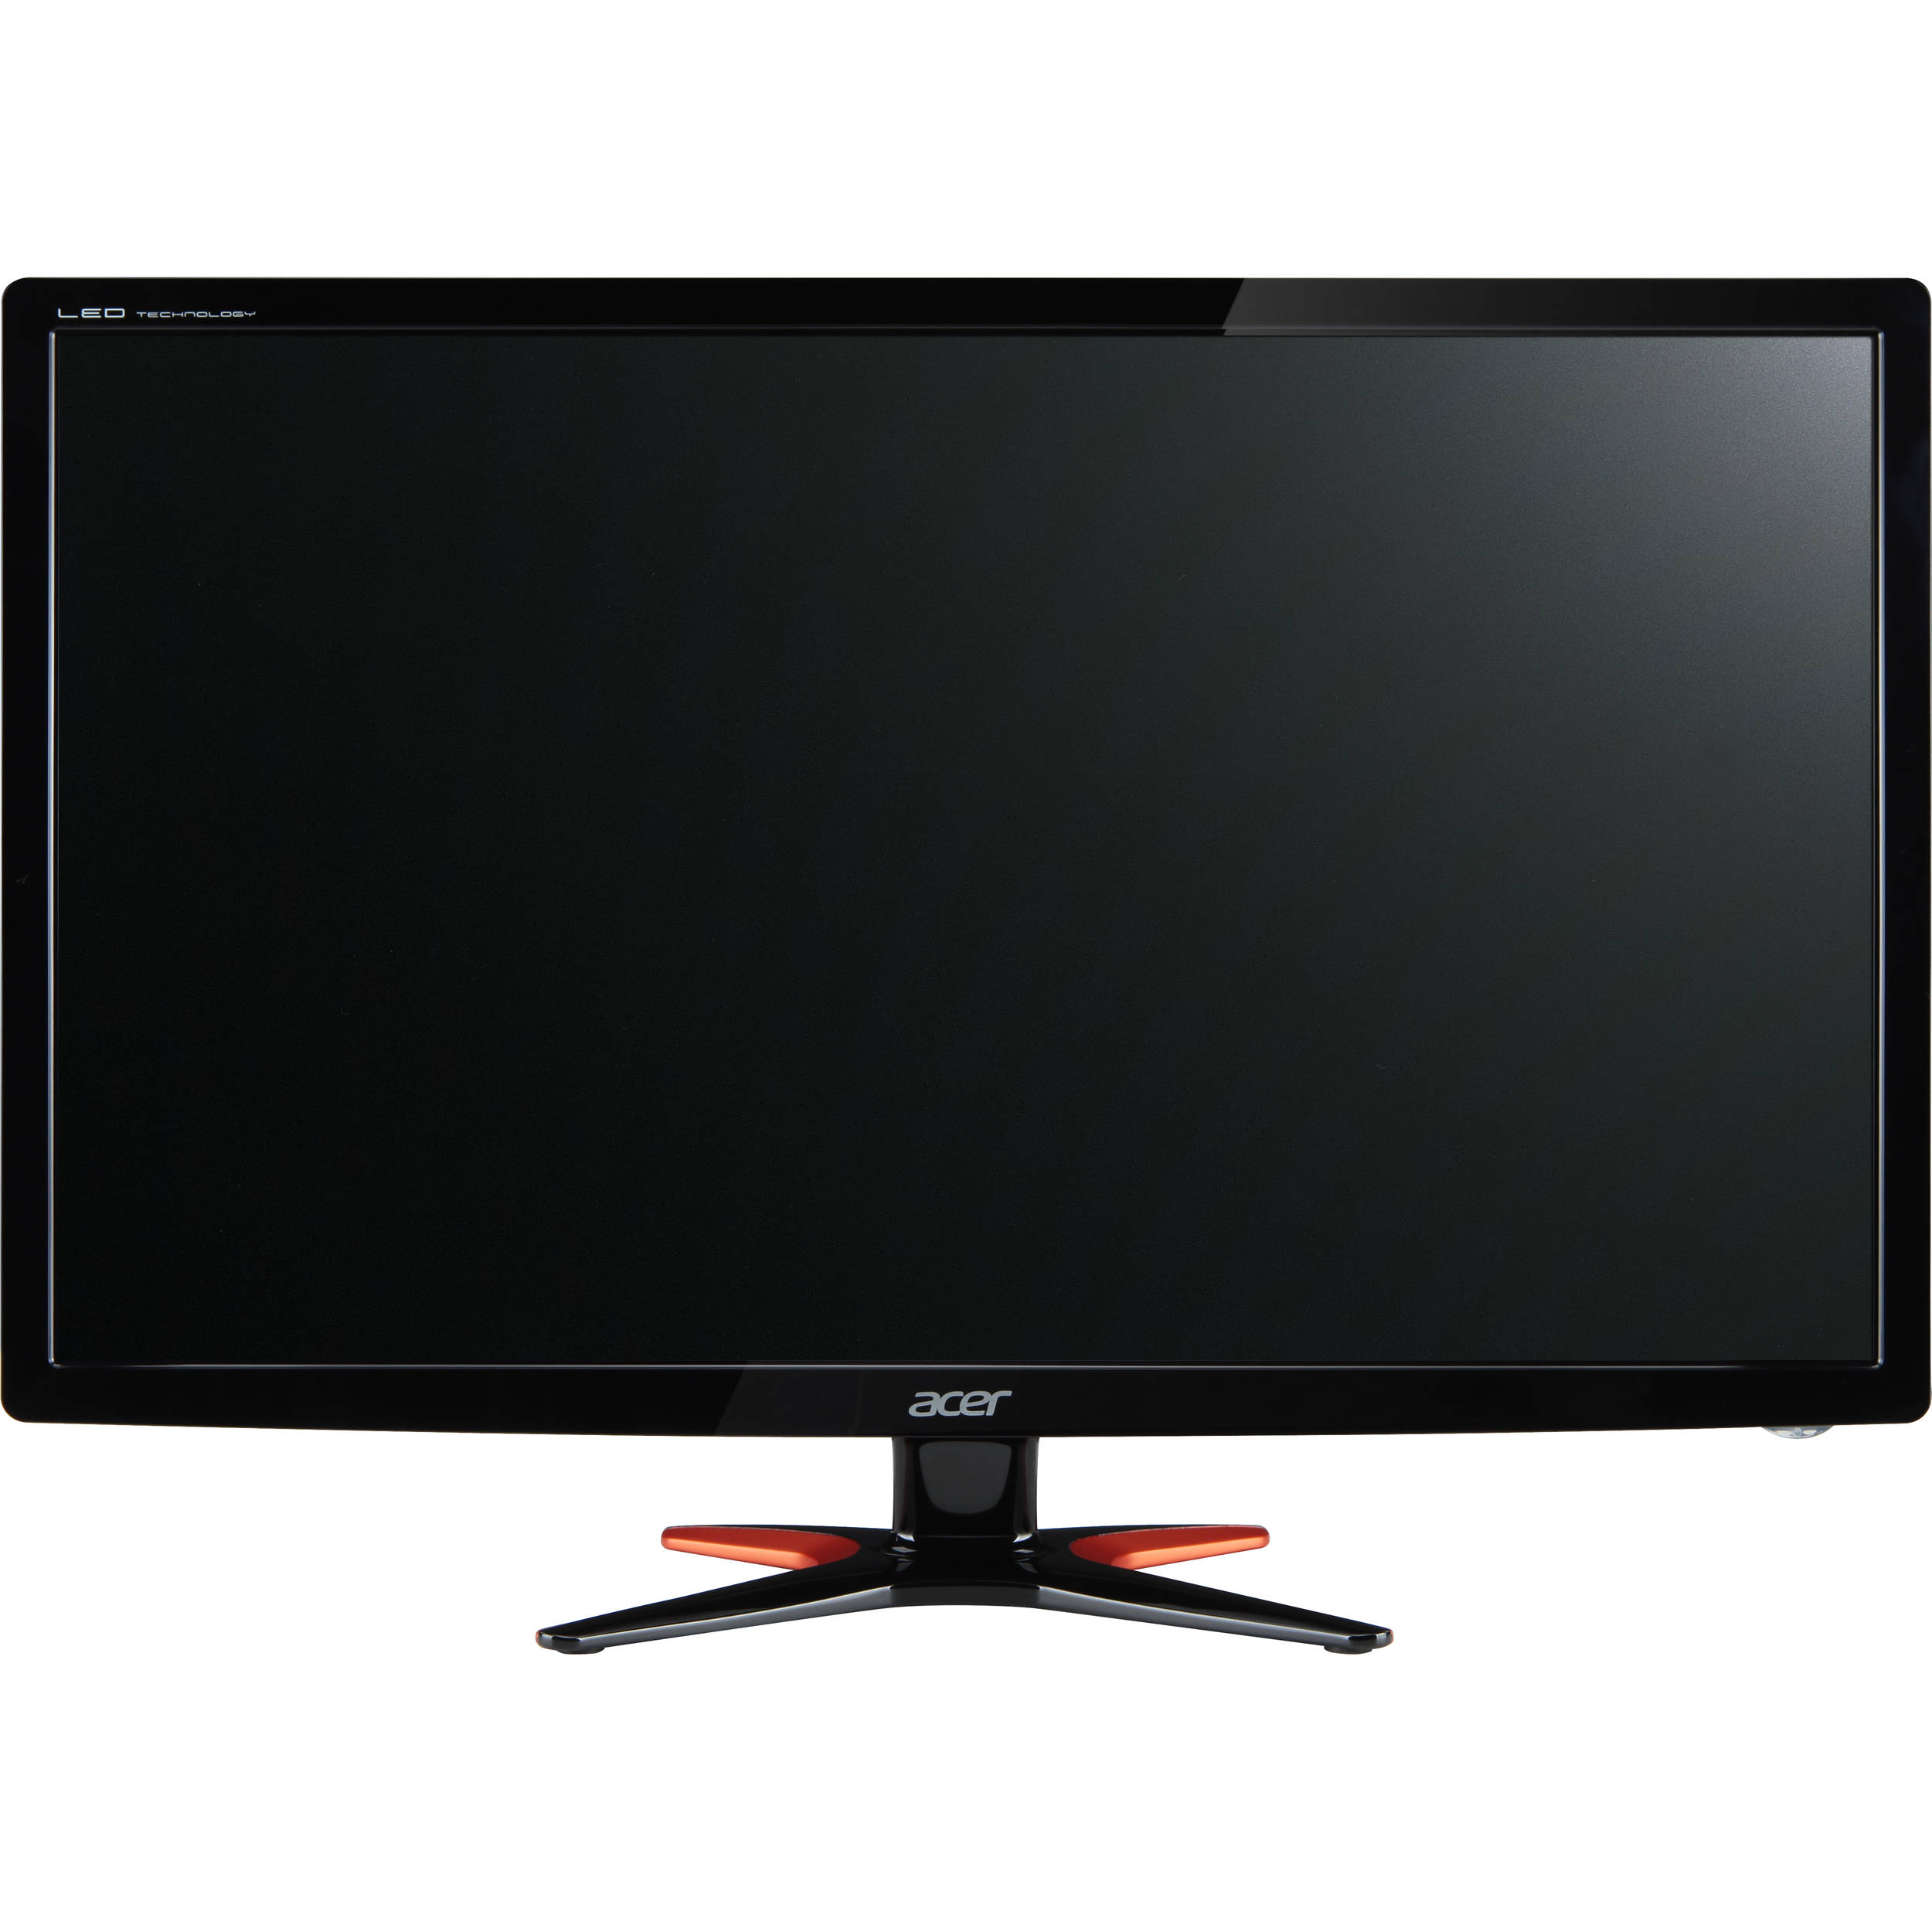

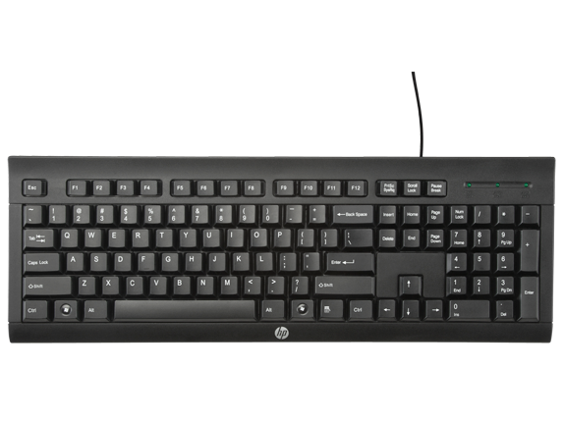


The Hardware

Slide 4
The Code

Slide 5
The Process
Week | Goals | Of Note
1
2
3
4
5
Final

Slide 6
Challenges

Slide 7
Lessons Learned

